Slide 1
Chapter 3.5 A simple Intro towards Core-Set ------From a Layered Sampling Perspective
李钊佚
2021 Nov. 29th

Slide 2
Synopsis
@1: What is Core-Set and Why we need Core-Set?
@2: Core-Set for K-Median Algorithm(ke chen et al, SIAM2009)
@3: Core-Set for Robusted Optimization Problems(Hu Ding, Zixiu Wang, ICML2020)
@4: Core-Set for Streaming Data
@5: The applications of Core-Set

Slide 3
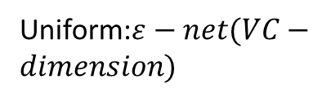

@1: What is Core-Set and Why we need Core-Set?
The Motivation of introducing Core-Set concepts for us：
Reducing the scale of data is important as we are doing data-mining tasks and machine learning tasks with mass data.
Let us suppose that all of the data could be formally defined as the matrix $R^{s×d}$, in which parameter s represents the amount of data points and parameter d represents the dimensionality of each data point.
So Now all we need is to reduce the scale of the matrix $R^{s×d}$, namely reduce the parameter s or d.
Data Matrix
Input data size s
Uniform:$ε−net(VC−dimension)$
Sampling
Non-Uniform: Core-Set
Input data dimensionality d
PCA, LDA, JL-Transform etc.

Slide 4

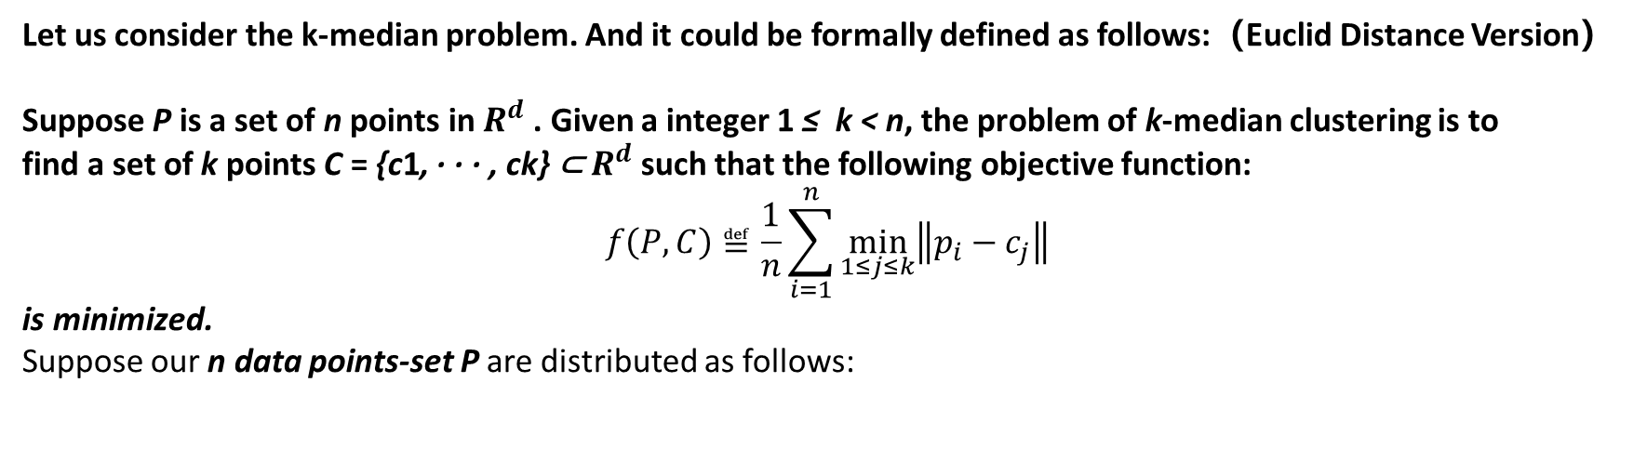
Now we are considering reducing the param s and there is a naïve sampling method – uniformly sampling.
But uniformly sampling would always behave unacceptably for its performance on algorithmic approximation ratio.
Let us consider the k-median problem. And it could be formally defined as follows:（Euclid Distance Version）
Suppose P is a set of n points in $R^{d}$ . Given a integer 1 ≤ k < n, the problem of k-median clustering is to
find a set of k points C = {c1, · · · , ck} ⊂ $R^{d}$ such that the following objective function:
$$f\left(P,C\right)≝\frac{1}{n}\sum_{i=1}^{n}{\min_{1≤j≤k}\left\|p_{i}−c_{j}\right\|}$$
is minimized.
Suppose our n data points-set P are distributed as follows:
The worst case:
The algorithmic approximation-ratio would be $∞$ if we did not sample the right one single point.
Because Optimal-Cost $≈$ 0 and Real-Cost $≈d$,
Approx $=$ $\frac{Real−Cost}{Optimal−Cost}$ $≈∞$
distance =d
one single point
There are n-1 points and any distance between two of them approach to zero.
Uniformly Sampling Result

Slide 5

Now We are going to demonstrate the following inference: (suppose n is big enough(approaching to $∞$))
We are supposed to sample at least $c∙n$ points, where 0$<c<1$and c is a constant, to ensure that we could cover the right single point in our sampling data points set.
Prof:

Slide 6
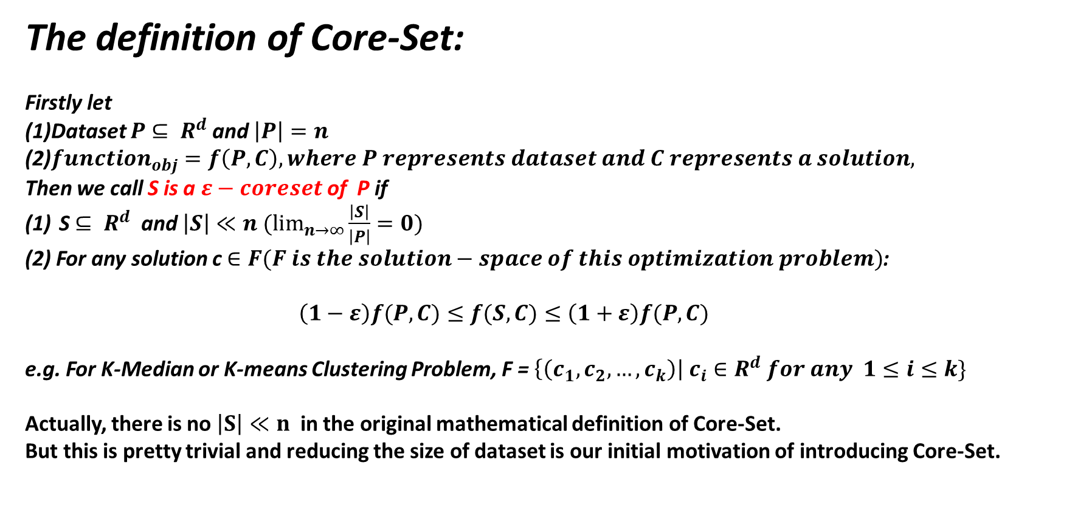
The definition of Core-Set:
Firstly let
(1)Dataset $P$ $⊆ R^{d}$ and $\left|P\right|=n$
(2)$function_{obj}=f\left(P,C\right), where P represents dataset and C represents a solution,$
Then we call S is a $ε−coreset$ of P if
S $⊆ R^{d}$ and $\left|S\right|≪n (\lim_{n→∞}{\frac{\left|S\right|}{\left|P\right|}}=0)$
(2) For any solution c $∈F(F is the solution−space of this optimization problem)$:
$\left(1−ε\right)f(P,C)≤f(S,C)≤\left(1+ε\right)f(P,C)$
e.g. For K-Median or K-means Clustering Problem, F = $\left\{\left(c_{1},c_{2},…,c_{k}\right)\right| c_{i}∈R^{d} for any 1≤i≤k\}$
Actually, there is no $\left|S\right|≪n$ in the original mathematical definition of Core-Set.
But this is pretty trivial and reducing the size of dataset is our initial motivation of introducing Core-Set.

Slide 7
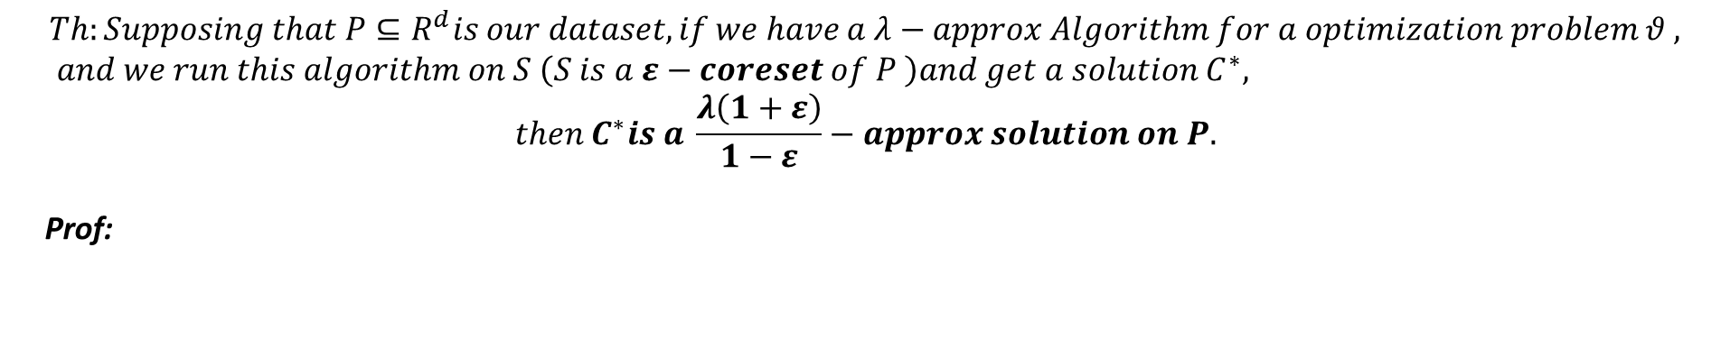
$$Th:Supposing that P⊆R^{d}is our dataset, if we have a λ−approx Algorithm for a optimization problem θ , and we run this algorithm on S \left(S is a ε−coreset of P \right)and get a solution C^{∗},$$
$$then C^{∗}is a \frac{λ\left(1+ε\right)}{1−ε}−approx solution on P.$$
Prof:

Slide 8
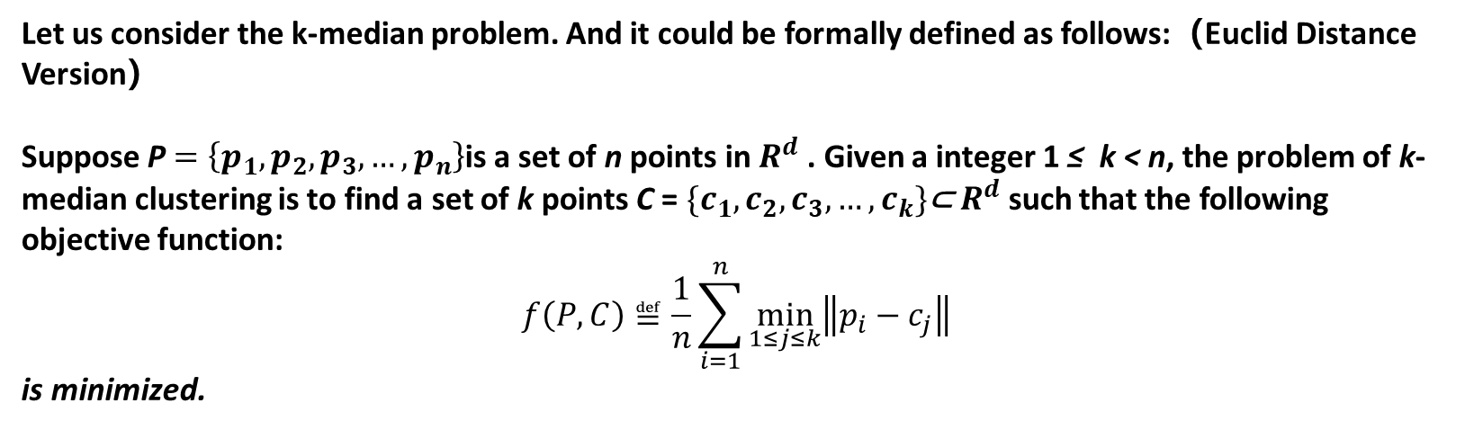
@2: Core-Set for K-Median Algorithm
Let us consider the k-median problem. And it could be formally defined as follows:（Euclid Distance Version）
Suppose P $=\left\{p_{1},p_{2},p_{3},…,p_{n}\right\}$is a set of n points in $R^{d}$ . Given a integer 1 ≤ k < n, the problem of k-median clustering is to find a set of k points C = $\{c_{1},c_{2},c_{3},…,c_{k}\}$⊂ $R^{d}$ such that the following objective function:
$$f\left(P,C\right)≝\frac{1}{n}\sum_{i=1}^{n}{\min_{1≤j≤k}\left\|p_{i}−c_{j}\right\|}$$
is minimized.

Slide 9


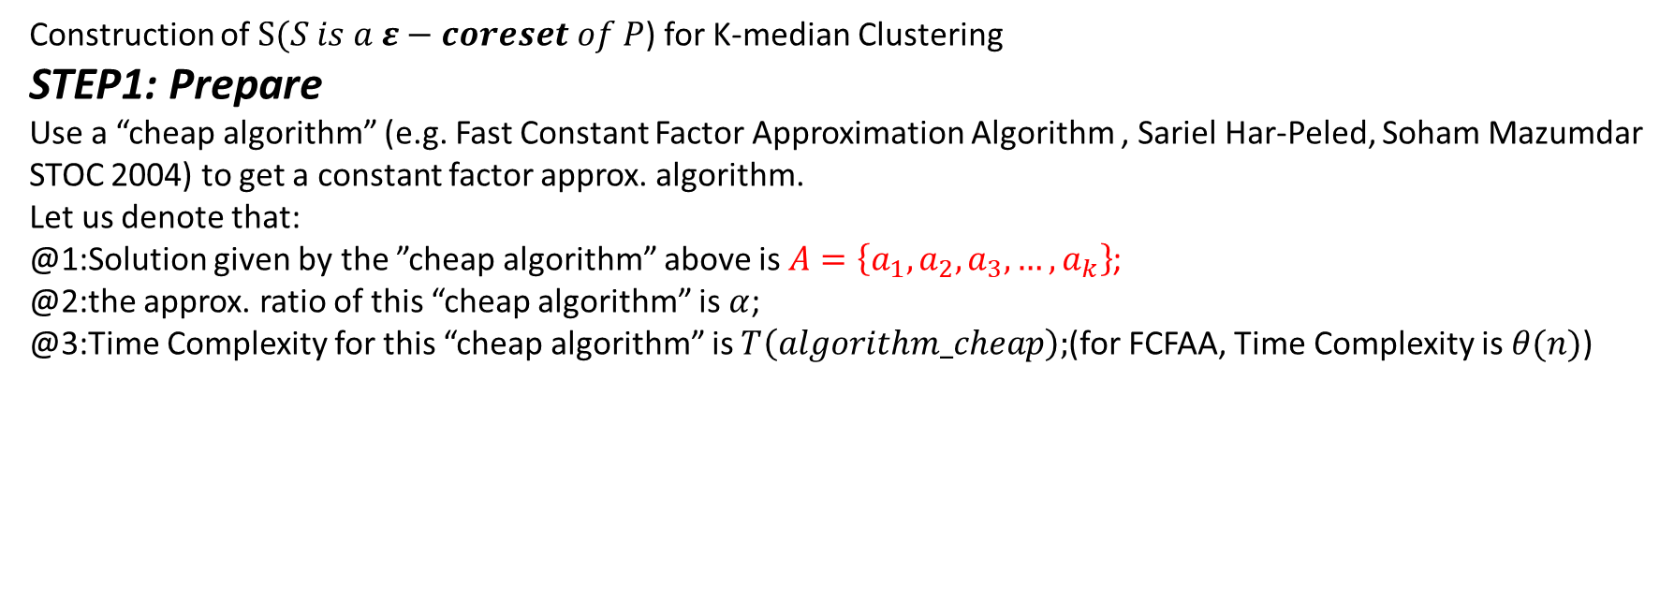



Construction of $S(S is a ε−coreset of P$) for K-median Clustering
STEP1: Prepare
Use a “cheap algorithm” (e.g. Fast Constant Factor Approximation Algorithm , Sariel Har-Peled, Soham Mazumdar STOC 2004) to get a constant factor approx. algorithm.
Let us denote that:
@1:Solution given by the ”cheap algorithm” above is $A=\left\{a_{1},a_{2},a_{3},…,a_{k}\right\}$;
@2:the approx. ratio of this “cheap algorithm” is $α$;
@3:Time Complexity for this “cheap algorithm” is $T\left(algorithm_cheap\right);$(for FCFAA, Time Complexity is$θ(n)$)
$$a_{3}$$
$$a_{1}$$
$$a_{k}$$
$$a_{4}$$
$$a_{k−1}$$

Slide 10



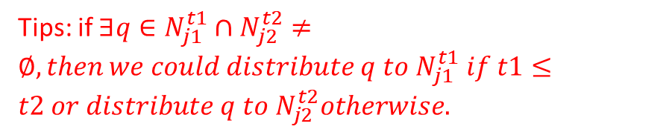







STEP2: Partition the data point space into layers
Tips: if $∃q∈N_{j1}^{t1}∩N_{j2}^{t2}≠∅, then we could distribute q to N_{j1}^{t1} if t1≤t2 or distribute q to N_{j2}^{t2}otherwise.$
$$a_{3}$$
$$a_{1}$$
$$a_{k}$$
$$2R$$
$$R$$
$$a_{2}$$
$$a_{k−1}$$
$$4R$$
$$for ∀a_{j}\left(1≤j≤k\right), partition for φ+1 layers;$$
$$φ= \log_{2}\left(αn\right);R= \frac{1}{α}f\left(P,A\right);$$
$$Layer\#1:Ball\left(a_{j},R\right)≜N_{j}^{0};$$
$$Layer\#2:Ball\left(α_{j},2R\right)\backslash Ball\left(α_{j},R\right)≜N_{j}^{1};$$
$$Layer\#3:Ball\left(α_{j},2^{2}R\right)\backslash Ball\left(α_{j},2R\right)≜N_{j}^{2};$$
$$…$$
$$Layer\#φ:Ball\left(α_{j},2^{φ}R\right)\backslash Ball\left(α_{j},2^{φ−1}R\right)≜N_{j}^{φ};$$
$$2^{φ−1}R$$

Slide 11

Why $φ and R?$
$$Th:dataset P ⊆∪_{j=1}^{k}Ball\left(a_{j},2^{φ}R\right)$$
Prof:
$ifP ⊆∪_{j=1}^{k}Ball\left(a_{j},2^{φ}R\right) is false, then ∃p_{i}∉$ $∪_{j=1}^{k}Ball\left(a_{j},2^{φ}R\right).$
$$\overset{⇒}{}\min_{1≤j≤k}\left\|p_{i}−a_{j}\right\|>2^{φ}R−−−1$$
$$2^{φ}R=2^{\log_{2}{αn}}∙\frac{1}{α}f\left(P,A\right)$$
$$=αn∙\frac{1}{α}f\left(P,A\right)$$
$$=n∙f\left(P,A\right)$$
$$=\sum_{i=1}^{n}{\min_{1≤j≤k}}\left\|p_{i}−a_{j}\right\|−−−2$$
Taking 1 and 2 into consideration:
$$\overset{⇒}{}\min_{1≤j≤k}\left\|p_{i}−a_{j}\right\|>\sum_{i=1}^{n}{\min_{1≤j≤k}}\left\|p_{i}−a_{j}\right\|$$
Contradict!
$$\overset{⇒}{}P ⊆∪_{j=1}^{k}Ball\left(a_{j},2^{φ}R\right)$$

Slide 12
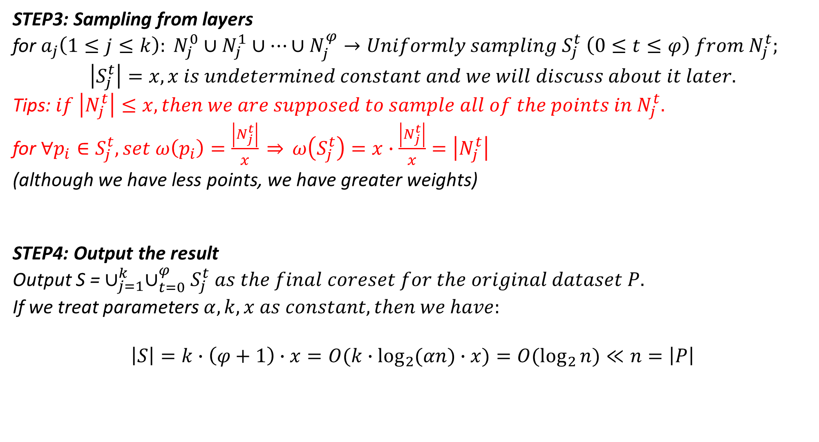
STEP3: Sampling from layers
for $a_{j}\left(1≤j≤k\right): N_{j}^{0}∪N_{j}^{1}∪…∪N_{j}^{φ}→Uniformly sampling S_{j}^{t} \left(0≤t≤φ\right) from N_{j}^{t};$
$$\left|S_{j}^{t}\right|=x, x is undetermined constant and we will discuss about it later.$$
Tips: $if \left|N_{j}^{t}\right|≤x,then we are supposed to sample all of the points in N_{j}^{t}.$
for $∀p_{i}∈S_{j}^{t}, set ω\left(p_{i}\right)=\frac{\left|N_{j}^{t}\right|}{x} \overset{⇒}{} ω\left(S_{j}^{t}\right)=x∙\frac{\left|N_{j}^{t}\right|}{x}=\left|N_{j}^{t}\right|$
(although we have less points, we have greater weights)
STEP4: Output the result
Output S = $∪_{j=1}^{k}∪_{t=0}^{φ}S_{j}^{t} as the final coreset for the original dataset P.$
If we treat parameters $α,k,x as constant,then we have:$
$$\left|S\right|=k∙\left(φ+1\right)∙x=O(k∙\log_{2}{(αn})∙x)=O(\log_{2}{n})≪n=\left|P\right|$$

Slide 13






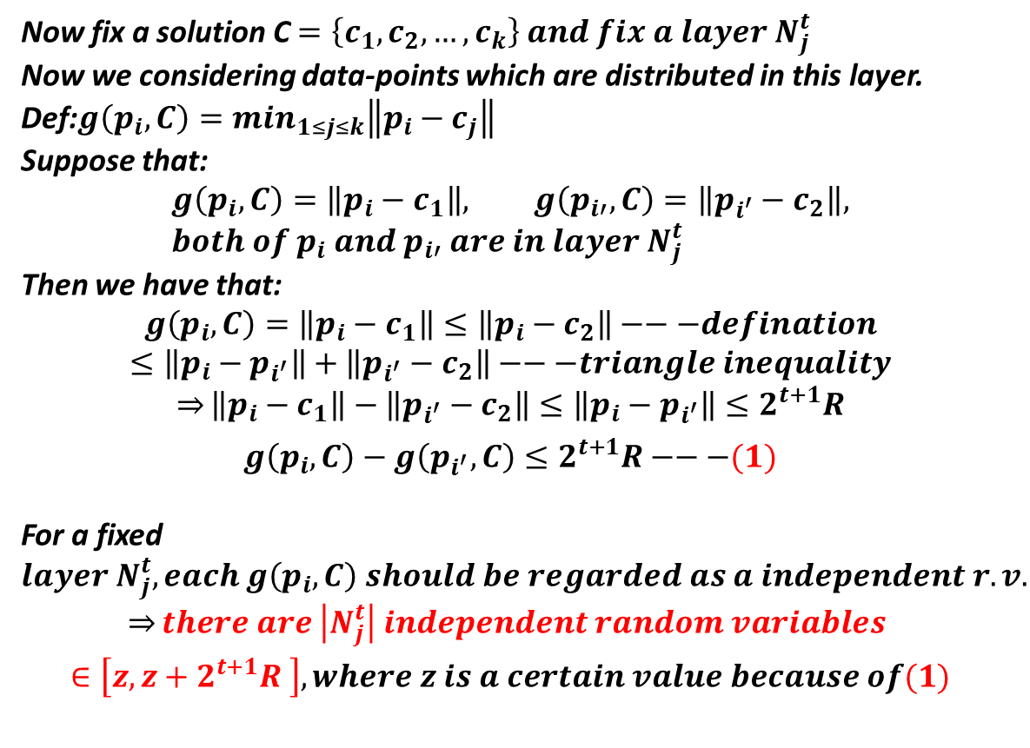














Now we are going to determine $x= ?$
Now fix a solution C $=\left\{c_{1},c_{2},…,c_{k}\right\} and fix a layer N_{j}^{t}$
Now we considering data-points which are distributed in this layer.
Def:$g\left(p_{i},C\right)=\min_{1≤j≤k}\left\|p_{i}−c_{j}\right\|$
Suppose that:
$$g\left(p_{i},C\right)=\left\|p_{i}−c_{1}\right\|, g\left(p_{i′},C\right)=\left\|p_{i^{′}}−c_{2}\right\|, {both of p}_{i} and{ p}_{i′} are in layer N_{j}^{t}$$
Then we have that:
$$g\left(p_{i},C\right)=\left\|p_{i}−c_{1}\right\|≤\left\|p_{i}−c_{2}\right\|−−−defination$$
$$≤\left\|p_{i}−p_{i^{′}}\right\|+\left\|p_{i^{′}}−c_{2}\right\|−−−triangle inequality$$
$$\overset{⇒}{}\left\|p_{i}−c_{1}\right\|−\left\|p_{i^{′}}−c_{2}\right\|≤\left\|p_{i}−p_{i^{′}}\right\|≤2^{t+1}R$$
$$g\left(p_{i},C\right)−g\left(p_{i^{′}},C\right)≤2^{t+1}R−−−(1)$$
For a fixed $layer N_{j}^{t}, each g\left(p_{i},C\right) should be regarded as a independent r.v.$
$$\overset{⇒}{}there are \left|N_{j}^{t}\right| independent random variables$$
$$∈\left[z, z+2^{t+1}R \right], where z is a certain value because of(1)$$
$$2^{t}R$$
$$2^{t−1}R$$
$$aj$$
$$p_{i}$$
$$p_{i′}$$
$$Now we are going to use Hoeffding Bound to decide x for ensuring our sampling result could represent$$
$$all of the data−points in this layer N_{j}^{t}(with a high probability).$$

Slide 14
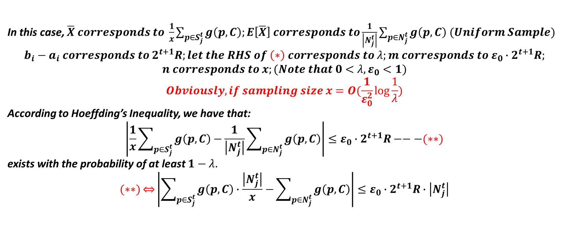
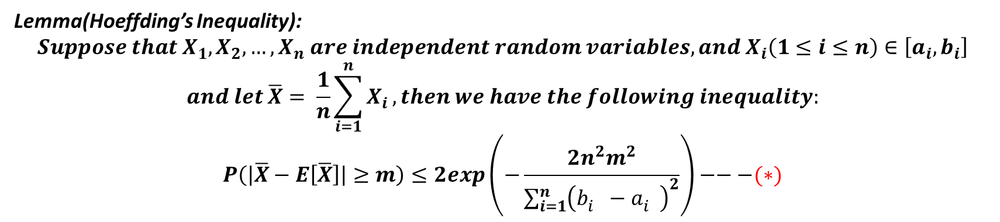
Lemma(Hoeffding’s Inequality):
$$Suppose that X_{1},X_{2},…,X_{n} are independent random variables, and X_{i}\left(1≤i≤n\right)∈\left[a_{i},b_{i}\right]$$
$$and let \overline{X}= \frac{1}{n}\sum_{i=1}^{n}{X_{i}},then we have the following inequality:$$
$$P\left(\left|\overline{X}−E\left[\overline{X}\right]\right|≥m\right)≤2exp\left(−\frac{2n^{2}m^{2}}{\sum_{i=1}^{n}{{\left(b_{i}^{}−a_{i}^{}\right)}^{2}}}\right)−−−(∗)$$
In this case, $\overline{X} corresponds to \frac{1}{x}\sum_{p∈S_{j}^{t}}{g\left(p,C\right);E\left[\overline{X}\right] corresponds to\frac{1}{\left|N_{j}^{t}\right|}\sum_{p∈N_{j}^{t}}{g\left(p,C\right) (Uniform Sample)} }$
$$b_{i}−a_{i} corresponds to 2^{t+1}R;let the RHS of \left(∗\right) corresponds to λ;m corresponds to ε_{0}∙2^{t+1}R;$$
$$n corresponds to x;(Note that 0<λ,ε_{0}<1)$$
$$Obviously, if sampling size x=O(\frac{1}{ε_{0}^{2}}\log{\frac{1}{λ}})$$
According to Hoeffding’s Inequality, we have that:
$$\left|\frac{1}{x}\sum_{p∈S_{j}^{t}}{g\left(p,C\right)−}\frac{1}{\left|N_{j}^{t}\right|}\sum_{p∈N_{j}^{t}}{g\left(p,C\right)}\right|≤ε_{0}∙2^{t+1}R−−−(∗∗)$$
exists with the probability of at least $1−λ.$
$$(∗∗)\overset{⇔}{}\left|\sum_{p∈S_{j}^{t}}{g\left(p,C\right)∙\frac{\left|N_{j}^{t}\right|}{x}−}\sum_{p∈N_{j}^{t}}{g\left(p,C\right)}\right|≤ε_{0}∙2^{t+1}R∙\left|N_{j}^{t}\right|$$

Slide 15
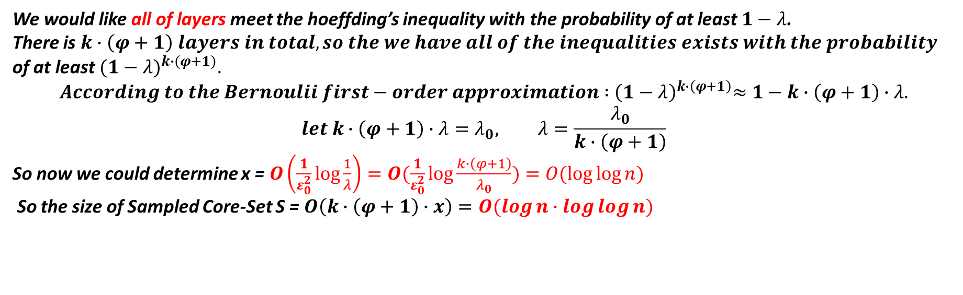
We would like all of layers meet the hoeffding’s inequality with the probability of at least $1−λ$.
There is $k∙\left(φ+1\right) layers in total, so the we have all of the inequalities exists with the probability$
of at least${ (1−λ)}^{k∙(φ+1)}.$
$$According to the Bernoulii first−order approximation :{ \left(1−λ\right)}^{k∙\left(φ+1\right)}≈1−k∙\left(φ+1\right)∙λ.$$
$$let k∙\left(φ+1\right)∙λ=λ_{0}, λ=\frac{λ_{0}}{k∙\left(φ+1\right)}$$
So now we could determine x = $O\left(\frac{1}{ε_{0}^{2}}\log{\frac{1}{λ}}\right)=O(\frac{1}{ε_{0}^{2}}\log{\frac{k∙\left(φ+1\right)}{λ_{0}})=O(\log{\log{n}})}$
So the size of Sampled Core-Set S = $O\left(k∙\left(φ+1\right)∙x\right)=O(\log{n}∙\log{\log{n)}}$

Slide 16
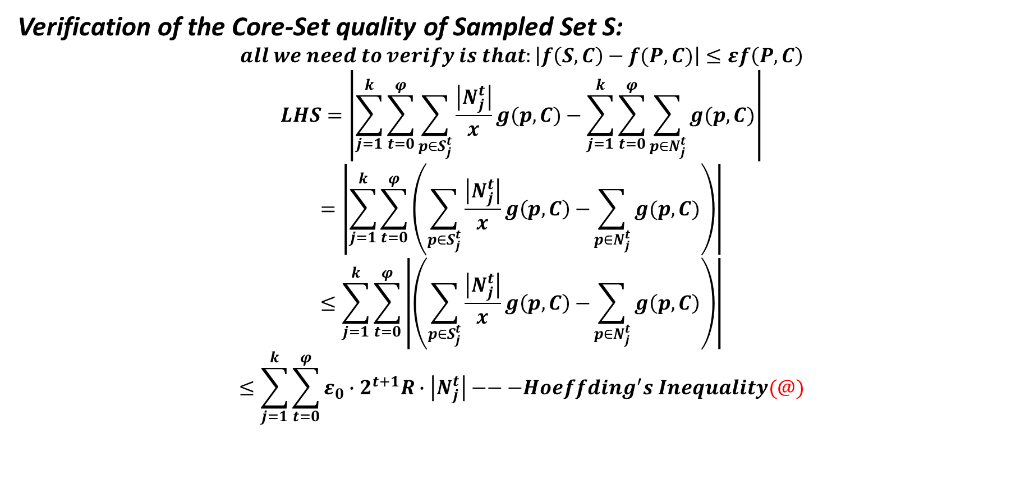
Verification of the Core-Set quality of Sampled Set S:
$$all we need to verify is that:\left|f\left(S,C\right)−f(P,C)\right|≤εf\left(P,C\right)$$
$$LHS=\left|\sum_{j=1}^{k}{\sum_{t=0}^{φ}{\sum_{p∈S_{j}^{t}}{\frac{\left|N_{j}^{t}\right|}{x}g(p,C)−\sum_{j=1}^{k}{\sum_{t=0}^{φ}{\sum_{p∈N_{j}^{t}}{g(p,C)}}}}}}\right|$$
$$=\left|\sum_{j=1}^{k}{\sum_{t=0}^{φ}{\left(\sum_{p∈S_{j}^{t}}{\frac{\left|N_{j}^{t}\right|}{x}g\left(p,C\right)−}\sum_{p∈N_{j}^{t}}{g(p,C)}\right)}}\right|$$
$$≤\sum_{j=1}^{k}{\sum_{t=0}^{φ}{\left|\left(\sum_{p∈S_{j}^{t}}{\frac{\left|N_{j}^{t}\right|}{x}g\left(p,C\right)−}\sum_{p∈N_{j}^{t}}{g\left(p,C\right)}\right)\right|}}$$
$$≤\sum_{j=1}^{k}{\sum_{t=0}^{φ}{ε_{0}∙2^{t+1}R∙\left|N_{j}^{t}\right|}}−−−Hoeffding^{′}s Inequality(@)$$

Slide 17
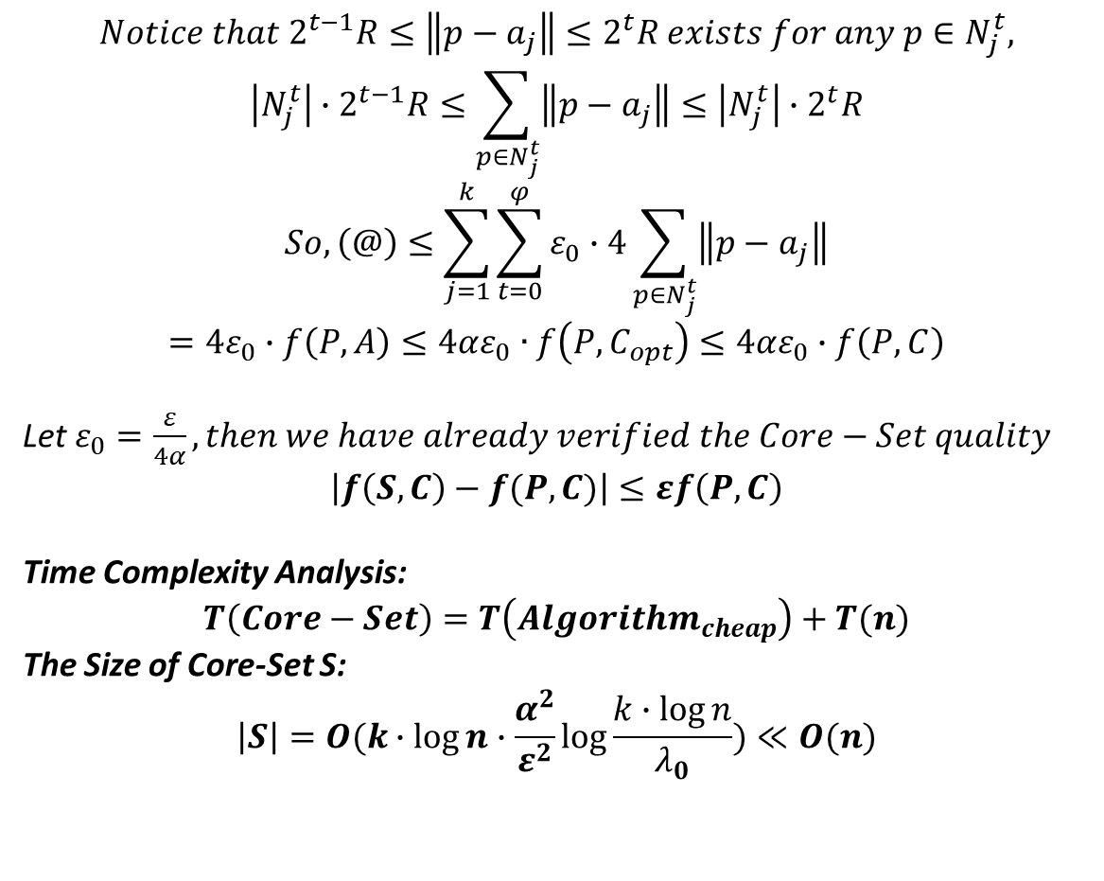

$$Notice that 2^{t−1}R≤\left\|p−a_{j}\right\|≤2^{t}R exists for any p∈N_{j}^{t},$$
$$\left|N_{j}^{t}\right|∙2^{t−1}R≤\sum_{p∈N_{j}^{t}}{\left\|p−a_{j}\right\|}≤\left|N_{j}^{t}\right|∙2^{t}R$$
$$So, \left(@\right)≤\sum_{j=1}^{k}{\sum_{t=0}^{φ}{ε_{0}∙4\sum_{p∈N_{j}^{t}}{\left\|p−a_{j}\right\|}}}$$
$$=4ε_{0}∙f\left(P,A\right)≤4αε_{0}∙f\left(P,C_{opt}\right)≤4αε_{0}∙f\left(P,C\right)$$
Let $ε_{0}=\frac{ε}{4α}, then we have already verified the Core−Set quality$
$$\left|f\left(S,C\right)−f(P,C)\right|≤εf\left(P,C\right)$$
Time Complexity Analysis:
$$T\left(Core−Set\right)=T\left(Algorithm_{cheap}\right)+T(n)$$
The Size of Core-Set S:
$$\left|S\right|=O(k∙\log{n}∙\frac{α^{2}}{ε^{2}}\log{\frac{k∙\log{n}}{λ_{0}}})≪O(n)$$
$$2^{t}R$$
$$2^{t−1}R$$
$$aj$$
$$p_{}$$

Slide 18
@4: Core-Set for Streaming Data

